Slide 1
Haar Cascade Training
A Simple Explanation
Gourab Nath

Slide 2
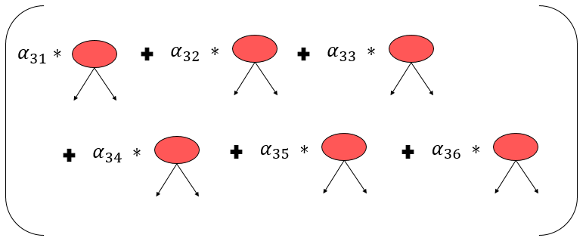
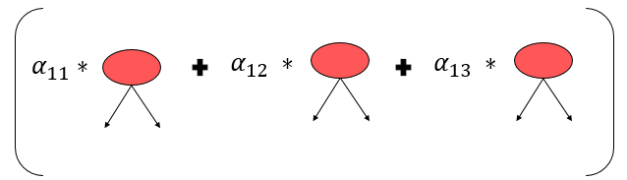

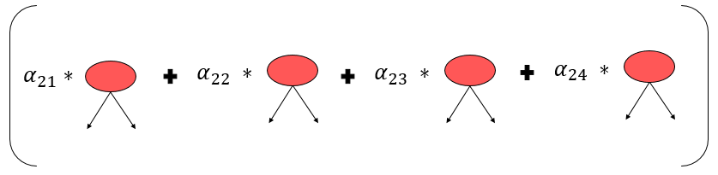
Haar Cascade Classifier
Layer 3
Layer 1
Layer 2

Slide 3






State 1:
$$α_{11}∗$$
$$fpr$$
$${≤FPR}_{stage} \&$$
$$tpr$$
$${≥TPR}_{stage}$$
$$is FALSE$$

Slide 4






State 1:
$$α_{11}∗$$
$$α_{12} ∗$$
$$fpr$$
$${≤FPR}_{stage} \&$$
$$tpr$$
$${≥TPR}_{stage}$$
$$is FALSE$$

Slide 5








State 1:
$$α_{11}∗$$
$$α_{12} ∗$$
$$α_{13} ∗$$
$$fpr{≤FPR}_{stage} \&$$
$${tpr≤TPR}_{stage}$$
$$is TRUE$$
$$fpr{≤FPR}_{overall} \&$$
$${tpr≤TPR}_{overall}$$
$$is TRUE$$
$$STOP$$

Slide 6

State 1:
$$α_{11}∗$$
$$α_{12} ∗$$
$$α_{13} ∗$$
$$fpr{≤FPR}_{stage} \&$$
$${tpr≤TPR}_{stage}$$
$$is TRUE$$
$$fpr{≤FPR}_{overall} \&$$
$${tpr≤TPR}_{overall}$$
$$is FALSE$$
$$CREATE ANOTHER CASCADE$$

Slide 7
Negative Images for stage 2
1. Delete the FALSE NEGATIVES and TRUE NEGATIVES detected by the Cascade 1
2. Generate some new negative examples
Set of greyscale images (with no human face)
A set of FALSE POSITIVES
n training
m validation

Slide 8




State 2:
Layer 1
Layer 2
$${fpr}_{attained}{≤FPR}_{overall} \&$$
$${{tpr}_{attained}≤TPR}_{overall}$$
$$is TRUE$$
$$STOP$$

Slide 9

State 2:
Layer 1
Layer 2
$${fpr}_{attained}{≤FPR}_{overall} \&$$
$${{tpr}_{attained}≤TPR}_{overall}$$
$$is FALSE$$
$$CREATE ANOTHER CASCADE$$

Slide 10
Generating Negative Images for stage 3
1. Delete the FALSE NEGATIVES and TRUE NEGATIVES detected by the previous Cascade
2. Generate some new negative examples
Set of greyscale images (with no human face)
A set of FALSE POSITIVES
n training
m validation

Slide 11




State 3:
Layer 3
Layer 1
Layer 2
$${if fpr}_{attained}{≤FPR}_{overall} \&$$
$${{tpr}_{attained}≤TPR}_{overall}$$
$$is FALSE$$
$$CREATE ANOTHER CASCADE$$
$$else STOP$$

